Slide 1
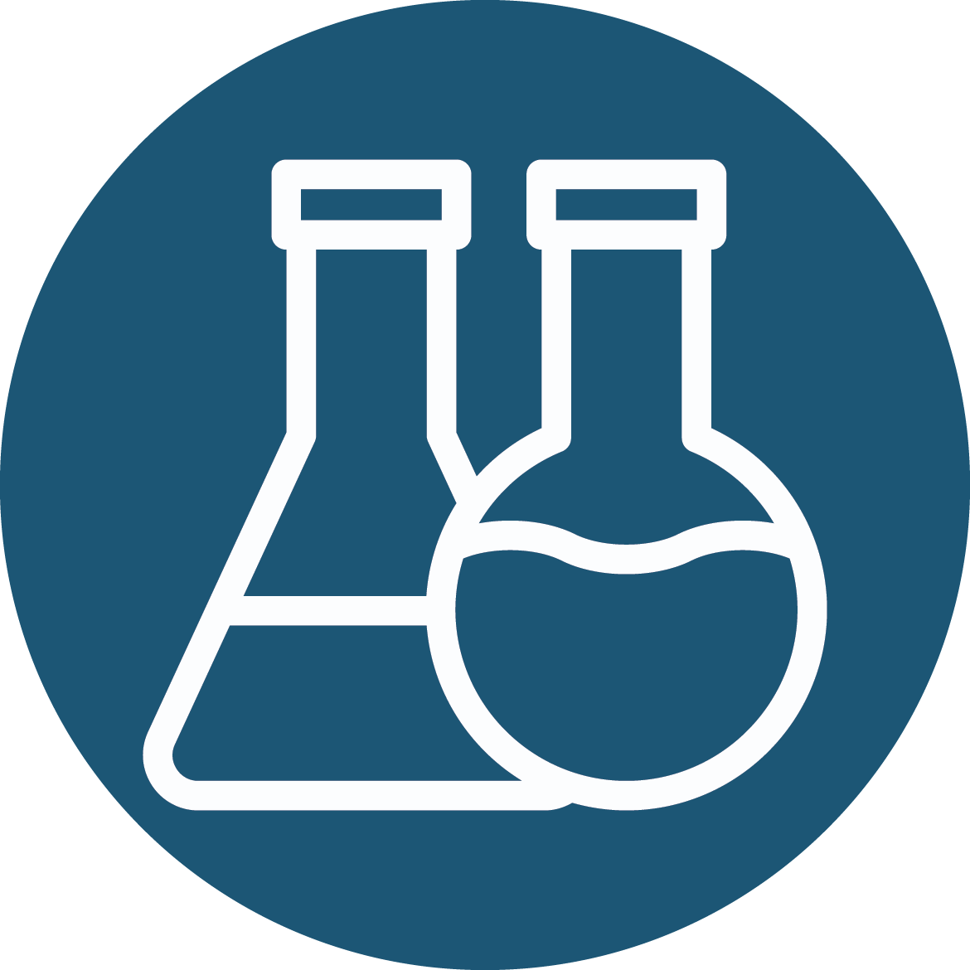
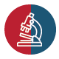
Roadmap to Unit 5 and Overview of Hemostasis Contributions of Platelets and Coagulation Factors
Erika Crouch, M.D., Ph.D.
Professor of Pathology and Immunology

Slide 2
Roadmap to Unit 5
The unit revolves around the pre-work for the LACE event. By the end of the unit, you should be able to describe the processes of primary vs secondary hemostasis and fibrinolysis.
Overview lectures include no new testable content but could enhance understanding. This overview is also supplemented with optional information relevant to clinical testing.
The required readings include all testable content except for Dr. Pennington’s lecture for the Pharmacology Thread, which examines anticoagulants, fibrinolytics, and antiplatelet agents.

Slide 3
Roadmap to Unit 5
Key terminology and histopathology to recognize are listed in the Hemostasis and Thrombosis Guide provided with the LACE ReqPrep.
In general, Practice Opportunities for units built around a LACE event emphasize the LACE quiz. However, based on student feedback we expanded the Practice Opportunities to include additional questions relating to clinical lab testing and anticoagulants.
Some content will be revisited and more clinically applied in Module 3 – Circulation and Breathing.

Slide 4
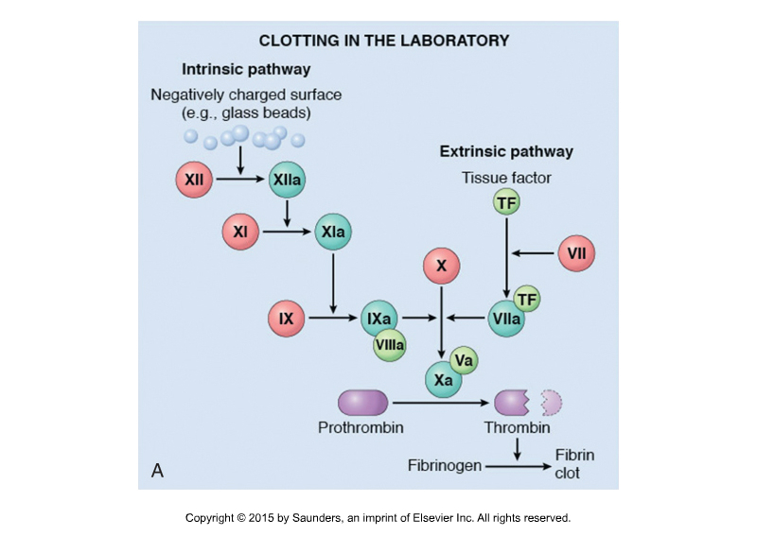
Roadmap to Unit 5
By the end of this unit, you should be able to apply your knowledge of coagulation factors and the laboratory pathways of coagulation to interpret simple clinical scenarios with lab test results (PT and aPTT) and normal values provided.

Slide 5
Event Objectives
Subset of LACE Objectives
Describe normal hemostasis, including the roles of platelets, tissue factor, and clotting factors.
Describe the contributions of platelets, coagulation cascades, and endothelial cells to blood clotting.
Describe the diverse activities of thrombin.
Describe the fibrinolytic cascade and the roles of plasmin and tissue plasminogen activator.
Explain how coagulation can be evaluated in the clinical laboratory.
Define hemorrhage and describe the terminology used to describe hemorrhagic lesions.
Notes:
Remember that this is an overview event. Although I will elaborate on some subjects there is no new testable content beyond that required for the LACE.
Hemostasis and thrombosis are subjects of considerable clinical importance but are also subjects of considerable complexity. I have relearned the coagulation cascade several times in my career, and I know I am not alone.

Slide 6
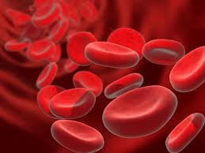
The Challenge
Blood must remain fluid yet instantly plug breaches in the vascular system.
Notes:
This is a major challenge. Achieving the necessary balance requires great biological complexity, the sort of complexity we explored in the immune system.

Slide 7
Definitions Blood Clot vs Thrombus*
Blood clots form at sites of a vascular breach, e.g., in association with bleeding into a cutaneous wound. They are a manifestation of hemostasis.
Thrombi are blood clots that form in the absence of a breach and within a vessel. They result from thrombosis, which is always pathologic.
Notes:
* Unfortunately, the terms are sometimes used interchangeably in the literature.

Slide 8
Hemostasis Following Injury Four Major Steps
Limit blood flow to the area of injury via transient vascular constriction.*
Primary hemostasis: form an initial platelet plug at the site of vascular break.
Secondary hemostasis: Clot or coagulate blood at the site of injury to form a more stable plug or blood clot
Stabilize the clot and initiate repair.
Notes:
*Vasoconstriction often contributes to initial hemostasis but is not primary hemostasis.
Formation of a platelet plug and the onset of coagulation are essentially simultaneous events.
Primary and secondary refer to the initial formation of a temporary platelet plug that is followed by a more stable or definitive plug that requires coagulation

Slide 9

Regulation of Hemostasis Three Major Players
Endothelial Cells (ECs)
Platelets
Coagulation Cascade
Where should we start?

Slide 10
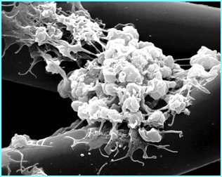
Platelets and Hemostasis Primary Hemostasis
Platelets form the primary plug (platelet plug) that initially seals vascular defects.
Platelets release mediators that contribute to the formation and stabilization of the plug and eventually contribute to vascular repair.
Membranes of activated platelets also provide a negatively charged surface for activating and concentrating coagulation factors.
SEM
Platelet plug
Notes:
** The definitive platelet plug is sometimes referred to as the permanent plug in the Robbins text, but it is rarely permanent.

Slide 11
Platelet Adhesion and Activation*
Adhesion
Activation
Aggregation
Provisional Platelet Plug
Definitive Platelet Plug **
Notes:
* Although usually described in the sequence above, activation and initial aggregation can occur almost instantaneously and simultaneously after adhesion. In some cases, activation may precede adhesion.
** The definitive platelet plug is sometimes referred to as the permanent plug in the Robbins text, but it is rarely permanent. It requires associated coagulation and will be described later.

Slide 12
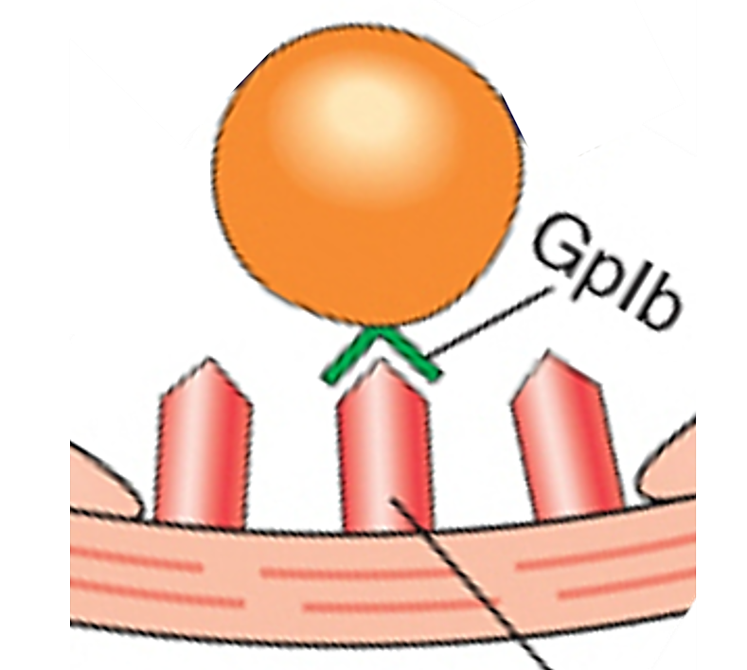
Initial Platelet Adhesion and Activation
Vascular Injury with Exposure of Subendothelial Matrix
Platelet
von Willebrand Factor (vWF)*
GP1b
Platelets with receptors for vWF (GpIb) and collagen **
EC
EC
Initial Platelet Adhesion and Activation
vWF
Notes:
*Some vWF is prebound to subendothelial matrix beneath uninjured endothelium, but is also circulating and can be discharged by ECs on demand
The interactions between platelets and exposed matrix are greatly simplified. EC = endothelial cell
** Glycoprotein Ib (GPIb) is a transmembrane protein that is a critical component of the platelet receptor complex that binds to vWF, which in turn binds to the subendothelial matrix, thereby contributing to initial platelet adhesion at the site of injury. Discussed in subsequent slides.
As entirely optional information for this event, stable interactions involve a cascading series of progressively stronger receptor mediated interactions mediated by multiple platelet receptors. For example:
GPIa/IIa integrin directly mediates binding to collagen.
Glycoprotein VI (GPVI) is important for stable binding to collagen and collagen-induced platelet activation and aggregation
Still others

Slide 13
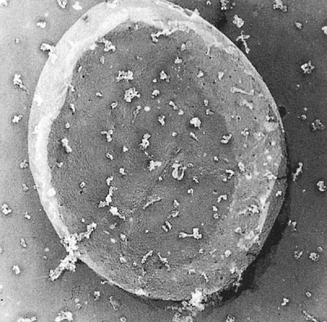
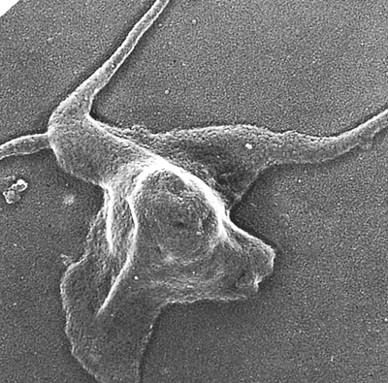
Platelets Effects of Adhesion and Activation
Resting
Activated & Contracted
Marked cytoskeletal reorganization
Notes:
Morphology of resting (left) and activated (right) platelets. Electron micrographic images of resting (A) and activated (B) platelets. Within moments of adhesion and activation the platelet undergoes dramatic alterations in shape and biochemical activity. Cytoskeletal rearrangements generate pseudopod-like extensions from the cell membrane. The shape changes greatly increase platelet membrane surface area. Furthermore, the structural composition of the membrane changes to provide binding sites for plasma coagulation proteins. (Adapted from Lind et al.)

Slide 14
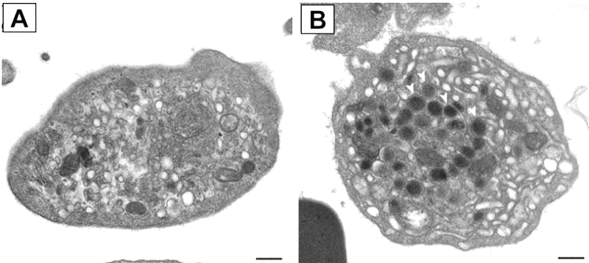
Platelet Granule Release Reactions* Pre-formed Mediators
δ-granules (delta/dense granules)
ADP
Ca²⁺
“Vasoactive” amines (serotonin, epinephrine), polyphosphates
TEM
δ
α-granules
P-selectin, which is expressed on membrane
vWF
Some coagulation factors: e.g., I, V
Several growth factors (e.g., PDGF, TGFβ), chemokines including Platelet Factor 4, angiogenic factors, cellular fibronectin, and more . . .
α
Quiescent Platelet
You do not need to be able to morphologically distinguish between the granules.
Notes:
* You do not need to know the details of platelet structure and will not be asked to morphologically distinguish between alpha or delta granules, just know they are there and generally what they contain.
Note that delta granules are relatively small and have low molecular weight mediators, while alpha granules are comparatively large and contain polypeptide mediators and coagulation proteins. I remember this with a mnemonic: delta/dense contains aDp. The molecules in alpha granules are proteins or peptides. At times in the past, the list of alpha-granule proteins included prothrombin and tissue factor protein or mRNAs; however, this remains controversial, at least for humans.
P-selectin is synthesized by megakaryocytes and endothelial cells. It binds to P-selectin glycoprotein ligand-1 (PSGL-1) which is expressed on platelets and almost all leukocytes. Interactions between P-selectin and PSGL-1 contribute to rolling interactions of platelets on endothelial cells.
Platelet factor 4 (PF4) is a positively charged chemokine that can bind and moderate the activity of endogenous endothelial heparins. It has a variety of other roles including the regulation of local innate immune responses and contributes to the pathogenesis of heparin-induced thrombocytopenia as discussed later.
Serotonin, histamine, and epinephrine can all help enhance platelet aggregation and may promote vasoconstriction.
Medium-chain polyphosphate (of the size secreted from activated human platelets) accelerates factor V activation, completely abrogates the anticoagulant function of tissue factor pathway inhibitor, enhances fibrin clot structure, and greatly accelerates factor XI activation by thrombin
* Platelet granules also contain XIII, which participates in crosslinking of fibrin, and plasminogen activator inhibitor (PAI), a negative regulator of plasmin, which can cleave fibrin in fibrin clots

Slide 15
Newly Generated Mediators
Thromboxane A2 (TXA2):
Stimulates platelet recruitment and activation (and other things including vasoconstriction)*
Synthesis from arachidonic acid is COX-1 dependent. Production inhibited by aspirin
Notes:
* Thromboxane A2 can also stimulate platelet recruitment and activation and increase the expression of platelet integrins that contribute to platelet aggregation. It is a product of arachidonic acid metabolism. Production of TXA2 is COX-1 dependent.

Slide 16
Activation Reorganizes Platelet Membranes
Membrane reorganization:
Increases membrane surface area
Promotes translocation of negatively charged phospholipids, particularly phosphatidylserine (PS), from the inner to outer membrane leaflet
Both events will play critical roles in coagulation.

Slide 17
Platelet Aggregation and Plug Formation
Adhesion
Activation
Aggregation
Provisional Platelet Plug
Definitive Platelet Plug

Slide 18
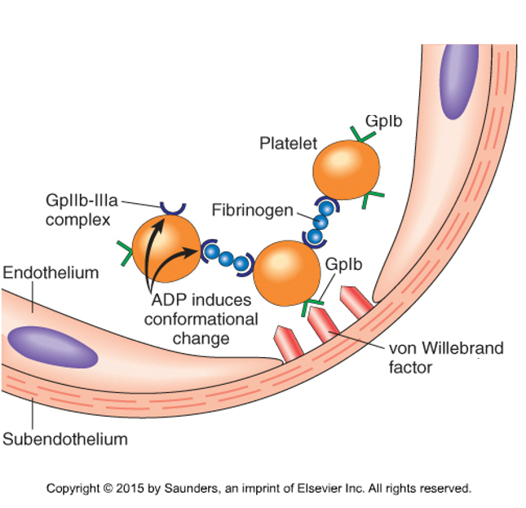
Platelet Aggregation Simplified Mechanism per Robbins
ADP-dependent conformational changes of platelet integrin GpIIb/IIIa allow bridging interactions with fibrinogen and/or vWF leading to aggregation**
Deficiencies in vWF, GpIb, or GpIIb/IIIa all lead to bleeding disorders.
Notes:
* GpIb is part of a complex: GpIb-GpIX-GpV that is very abundant on the surface of platelet. However, if you just remember GpIb you will be fine for Module 2. Adhesion involves more than GpIB binding to vWF.
**After the conformational change’ the GpIIb/IIIa integrin complex can under some circumstances bind to vWF, further promoting aggregation. Activation of GPIIb/IIIa also results in outside-in signaling with enhanced integrin dependent interactions with the platelet cytoskeleton that contribute to clot/plug retraction
As discussed in the reading, the deficiency of GpIb is referred to as Bernard-Soulier Syndrome, while deficiency of GpIIb/IIIa is referred to as Glanzmann Thrombasthenia.

Slide 19
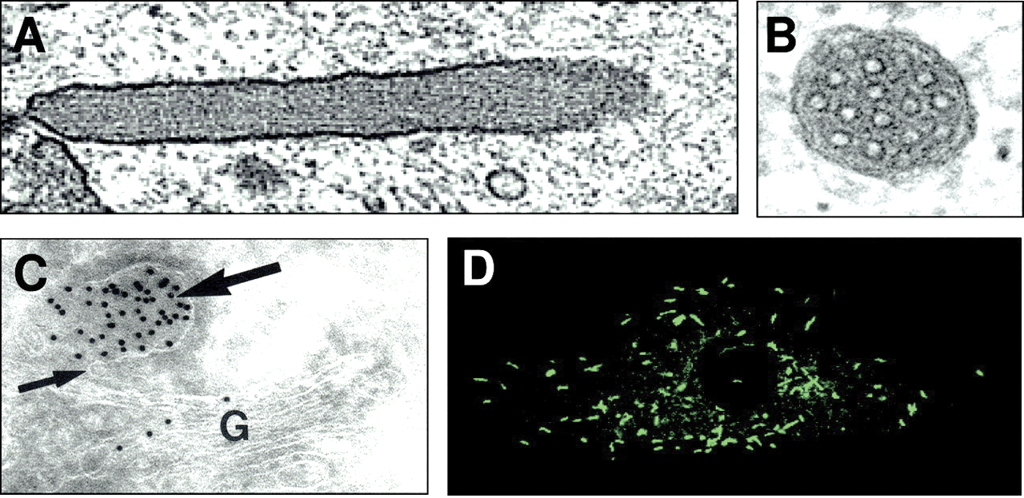
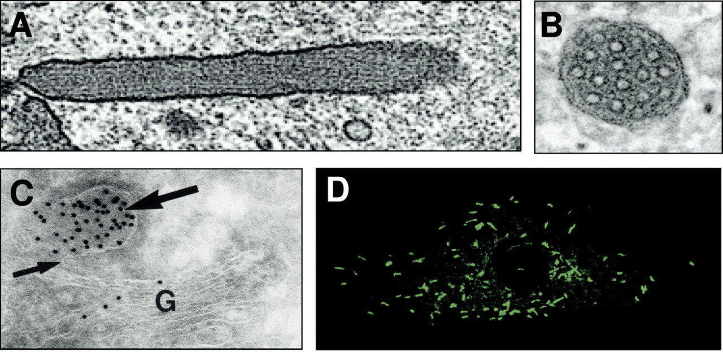
von Willebrand Factor (vWF) Mediates Initial Binding of Platelets at Sites of Injury
vWF is a glycoprotein synthesized by megakaryocytes and found in platelet granules
vWF is also synthesized by ECs and large multimers are stored in Golgi-derived secretory granules, Weibel-Palade bodies*
vWF in Endothelial Cells
Some vWF is pre-associated with the subendothelial matrix bound to collagen. However, larger multimers can be secreted apically on demand via discharge of W-P bodies
Some vWF is deposited as strings on the EC surface, some circulates in the blood in association with Factor VIII (more later)
Nucleus
IF of GFP-vWF
TEM
Weibel-Palade bodies
Nothing to recognize
Notes:
* W-P bodies have a tubular internal structure that includes folded vWF multimers that are many fold longer than the granule. W-P bodies contain various other products, but most notably factor VIII. The membranes contain P-selectin, which is transferred to the endothelial membrane during exocytosis.
Platelet and endothelial cell derived vWF may have different functions. Platelet vWF has the potential to augment EC-derived vWF at sites of injury.
Virtually all endothelial cells, except lymphatic endothelial cells, have at least some W-P bodies. Although the liver is a source of vWF, unlike clotting factors, it is synthesized by sinusoidal endothelial cells, not hepatocytes.

Slide 20
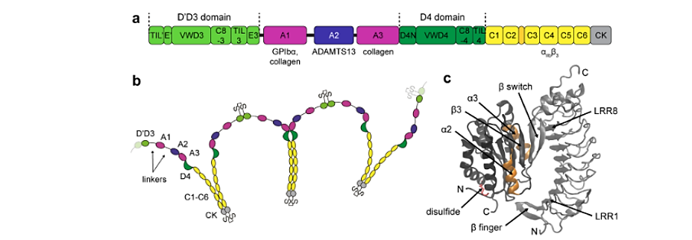
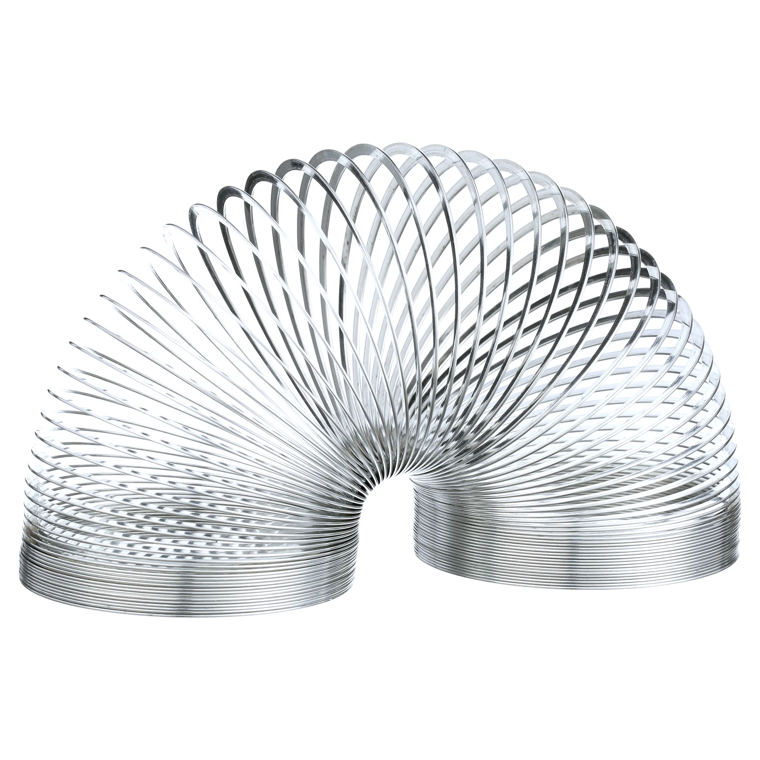
vWF Glycoprotein Structure Molecular Structure For Future Reference
Monomer (250 kDa)
Factor VIII binding
Platelets
Collagen
Collagen
Platelets / Integrins
Factor VIII binding
Multimers of dimers
Apical secretion of vWF multimers with exposure to luminal shear stress results in conformational changes that expose platelet binding sites and promote platelet binding and/or aggregation.
Multimers can be small or VERY large
500 – 20,000 kDa
Details of molecular structure and MW are not required for Module 2
Notes:
The diagram of the monomer shows the location of domains encoding various binding domains.
N-terminal binding site for factor VIII coagulation factor
A1 contains binding sites for platelet GPIb, heparin, collagen, and ristocetin (riss-tow-see-tn). The latter can induce vWF to bind and aggregate platelets in vitro, providing a clinical measure of vWF function
A2 contains the cleavage site for ADAMTS13
A3 contains the primary binding site for collagen
VWD4 and C domains involved in multimerization
C4 contains a binding site for integrins, including platelet GPIIb/IIIa
CCK contains the dimerization interface
There are more than 300 mutations in the VWF gene that can cause von Willebrand disease, a condition characterized by reduced or delayed clot formation, which results in prolonged bleeding following vascular injury. Whereas some mutations are associated with only slightly reduced levels VWF activity, others are associated with drastic reductions.
By contrast, mutations that interfere with the activity of ADAMTS13 cause diseases characterized by excess clotting and have been associated with familial thrombotic thrombocytopenic purpura, a rare disorder involving abnormal blood coagulation.
ADAMTS13 is predominantly synthesized in the liver by hepatic stellate cells (discussed in Module 4)

Slide 21
Key Concepts Distilled Essence of Primary Hemostasis
Platelets rapidly adhere, become activated, and aggregate at sites of exposed subendothelial matrix and vWF. Binding involves specific receptors including Gp1b.
Activated platelets release preformed mediators from δ-granules including ADP and calcium, and various protein mediators from α-granules.
Activated platelets synthesize Thromboxane A2. ADP and TXA2 enhance platelet recruitment, activation, and aggregation.
ADP induces conformational changes in integrin GpIIb/IIIa that allow bridging interactions with fibrinogen (or vWF) and resulting platelet aggregation.
vWF is synthesized by megakaryocytes and ECs and circulates in the blood with clotting Factor VIII.
Large multimers of vWF are stored in EC Weibel-Palade bodies and luminally secreted on demand to further develop the platelet plug.

Slide 22


Slide 23
Regulation of Normal Hemostasis
Endothelial Cells
Platelets
Coagulation Cascade
A cascade of serine protease activation leads to the conversion of prothrombin to thrombin. Thrombin converts fibrinogen to fibrin, which becomes crosslinked to form a stable plug.

Slide 24

Classic Lab Pathways of Coagulation
Inactive serine protease
clotting factor
Active serine protease
clotting factor
Non-enzymatic cofactor
Oh my! Not again . . .
“Common” Pathway:
X,V, Prothrombin (FII)
Robbins Basic Pathology (2013), Chapter 3, Fig 3.7A
Notes:
The goal is to generate a fibrin clot on activated and aggregated platelets at sites of injury. This involves the conversion of a large plasma protein, fibrinogen, to fibrin which assembles into fibrils and fibers. The generation of fibrin is catalyzed by thrombin, a serine protease.
Some parts you have to memorize.
You should remember the Factor X anchors the common or shared pathway.
I then work my way out from factor 10 on the intrinsic side as 8,9,10 (oh, already said that), 11, 12.
Fortunately, there are only few additional players for the extrinsic pathway: Tissue factor (FIII) and Factor VII.
In the Robbins diagram all the large circles or spheres and thrombin are serine proteases. Red circles are the inactive factors, blue are active. The smaller circles are non-enzymatic glycoprotein co-factors, which are included among the clotting factors
Major contributions by Earl Davie and Hans Neurath at UW Dept of Biochemistry
The intrinsic pathway is sometimes known as the contact pathway.

Slide 25
Nomenclature*
Factor I = F(I) = fibrinogen (Fg)
Factor II = F(II) or prothrombin (PT)
Factor III = F(III) or tissue factor (TF), the active component of “tissue thromboplastin”
Factor IV = calcium ions, no longer assigned
Factor VI proved to be Va, no longer assigned
Notes:
Fibrin (Fn) and thrombin are most often spelled out, prothrombin more variable.
Factor III is usually referred to as Tissue Factor.

Slide 26
Molecular Classes of Factors and Cofactors
Fibrinogen is a circulating glycoprotein
TF is a transmembrane glycoprotein
V and VIII are glycoprotein cofactors
All the remaining except for Factor XIII are serine proteases*
Notes:
* Factor XIII, fibrin stabilizing factor (not yet introduced) is a crosslinking enzyme, a transglutaminase

Slide 27
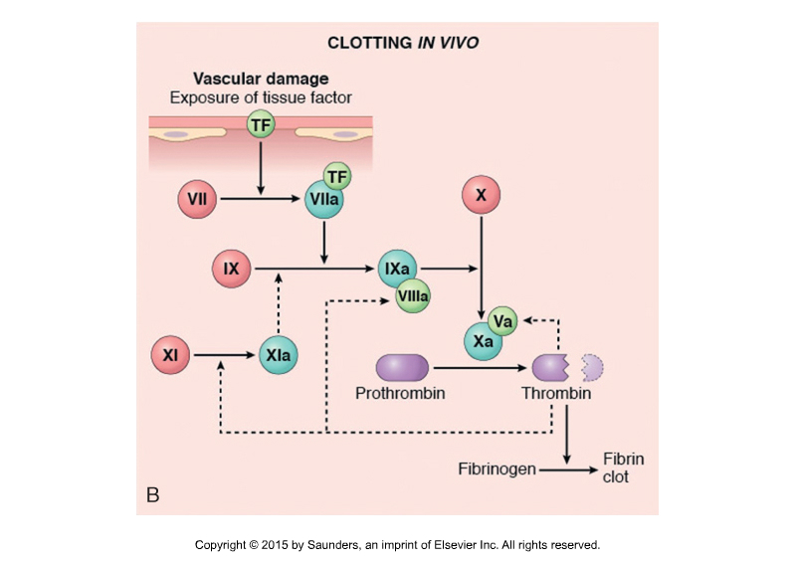
Pathway of Coagulation In Vivo In Vivo Tissue Factor Pathway
Combines elements of both lab pathways.
After initiation, thrombin amplifies the cascade at multiple points (dashed).
The next slide will display the same in vivo path in a different way so I can more easily make some specific points.
Robbins Basic Pathology (2013), Chapter 3, Fig 3.7B
Notes:
5,6,7,8,9,10,11 but there is no 6
5,8,11 provide thrombin dependent amplification

Slide 28
In Vivo Coagulation Cascade Tissue Factor Pathway (Unpacked or Unfolded)
Tissue Factor + VII
PL Ca++
IX
TF-VIIa
XIa
X
IXa
PL Ca++
Prothrombin
VIIIa
Xa
PL Ca++
Based on available data:
TF/VIIa complex is the most important activator of IX
IXa/VIIIa complex is the most important activator of X and the common pathway
Va
Thrombin-mediated activation/amplification
PL = platelet phospholipid
Ca++ = calcium
Thrombin
Fibrinogen
Fibrin
Notes:
Note that multiple steps required platelet membranes (PL, blue) and calcium (Ca++, green).
Thrombin cleaves fibrinogen to fibrin and promotes crosslinking of fibrin but also provides feedback amplification of the cascade at several points by activating clotting factors that are more proximal in the cascade, i.e., factors XI and VIII and V (red).
TF-VIIa can also activate factor X, but this may primarily contribute to initiation of the cascade. It is not as robust as the activation by IXa/VIIIa
The socalled “tenase complex” includes IXa, VIIIa, PL, Ca++
The socalled “prothrombinase complex includes Xa, Va, PL, Ca++

Slide 29
Evidence that this Pathway is Important in vivo
Deficiencies of Factors V, VII, VIII (Hemophilia A), IX (Hemophilia B), and X are associated with moderate to severe bleeding disorders.*
FXI deficiency is associated with milder bleeding disorders.
FXII deficiency is not associated with bleeding.
As optional information, it is also supported by various animal models. For example:
PT, TF, FV, FVII, and FX null mice show complete or partial perinatal lethality with hemorrhage
FVIII and FIX null mice are hemophilic and show excessive bleeding after injury
Notes:
Mnemonic for those associated with moderate to severe bleeding: 5, 6, 7, 8, 9, 10 . . . But there is no 6
FXI is associated with milder bleeding disorders, possibly because its role in vivo is largely limited to mediating feedback activation by thrombin. We’ll come back to Factor XII in the next event.
Some models suggest under appreciated complexities. For example, organ specific models suggest tissue specific differences that might relate to differences in TF expression.

Slide 30

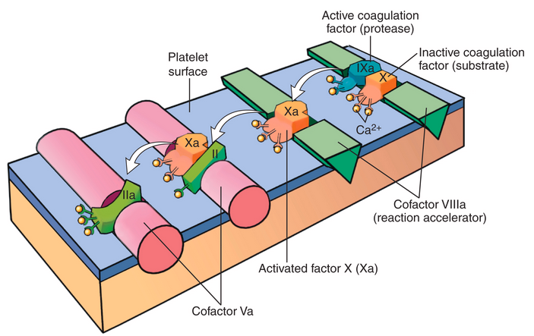
Review of Critical Roles of Platelet Membranes and Calcium
“Dancing” on Platelet Membranes
Activated factors, their inactive factor substrates, and cofactors are bound to membranes of activated platelets
Activated factors are “passed” to their substrate in a process likened to a dance.
Calcium binds to γ-carboxy-glutamic acid (Gla) residues in Factors II, VII, IX, and X, and mediates their binding to negatively charged platelet membranes.*
Gla is generated by vitamin K-dependent (and warfarin-sensitive) enzymes in the liver.
Robbins Basic Pathology, 2023 – Figure 3.8
Notes:
* I remember the vitamin K dependent factors (FII, FVII, FIX, FX) with the mnemonic: 2 + 7 = 9 not 10.
Activated platelets show redistribution of phosphatidylserine from the inner to the outer membrane leaflet. PS contributes to the negative charge and directly binds to calcium, cofactor, and clotting factor.
As discussed later, Protein C and Protein S, which contribute endogenous anticoagulant effects, are also vitamin K-dependent.

Slide 31
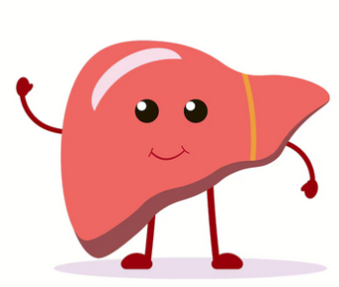
Critical Roles of the Liver
Liver parenchymal cells (hepatocytes) produce most coagulation factors, not just vitamin K-dependent factors: fibrinogen, prothrombin, Factor V, Factor VII, Factor IX, Factor X, Factor XI, Factor XII
Liver cells also produce 3 circulating anticoagulants including antithrombin III, Protein C, and Protein S (discussed soon)
Factor VIII is made in the liver but by endothelial cells lining the sinusoids. Who is left out? vWF, Factor XIII, and Tissue Factor
Liver disease can significantly impact coagulation, leading to bleeding or clotting disorders.
Notes:
As discussed in Unit 3, fibrinogen is an acute phase reactant.
Remember that thrombopoietin, which regulates the production of platelets by stimulating the growth and differentiation of megakaryocytes. is mainly synthesized in the liver.
Factor XIII is made in the bone marrow, mainly by megakaryocytes.

Slide 32
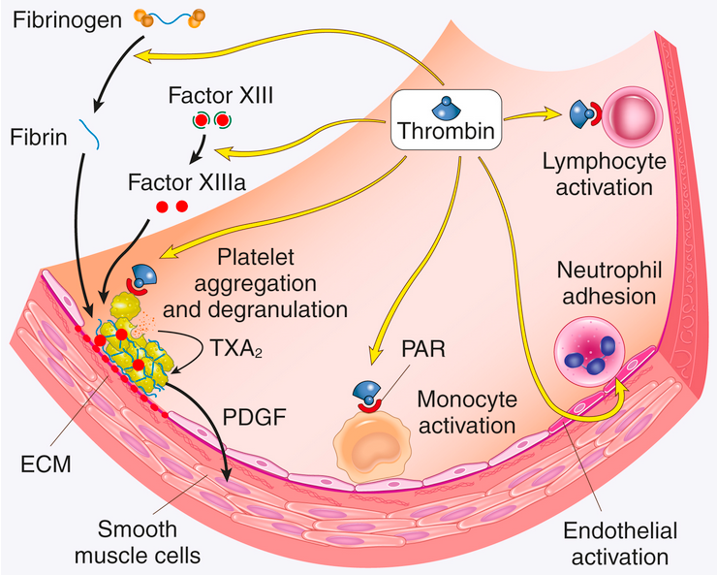
Diverse Activities of Thrombin
Proteolytic activity
Conversion of fibrinogen to fibrin
Activation of Factor XIII
Inhibit fibrinolysis via thrombin activated fibrinolysis inhibitor*
Mediated by Protease Activated Receptors (PARs)
Platelet adhesion, activation, and aggregation, recruitment
Endothelial activation
Monocyte and lymphocyte activation
Anticoagulant Effects via Thrombomodulin
Robbins Basic Pathology (2013), Chapter 3, Fig 3.9
Notes:
TAFI inhibits fibrinolysis by removing C-terminal lysine residues from partially degraded fibrin, which are essential binding sites for plasminogen and tissue plasminogen activator (t-PA). By eliminating these binding sites, activated TAFI (TAFIa) prevents the efficient activation of plasminogen to plasmin, thereby slowing down the dissolution of the fibrin clot

Slide 33
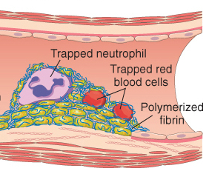
Thrombin and Platelets
Progressive Transformation of a Provisional to a Definitive Crosslinked Platelet Plug*
Recruit more platelets
Platelet Adhesion and Activation
Thrombin
PAR-1
Protease activated receptor-1
Fg
Aggregation Contraction
F(XIII)
Fibrin
Factor XIIIa
transglutaminase
RBCs and leukocytes contribute to structure and function of the plug
Definitive Plug
Notes:
*This complex slide has a build.
The conversion of the initial and provisional platelet plug to the definitive platelet plug involves additional steps. Thrombin generated by the coagulation cascade promotes platelet recruitment, activation, and contraction. Cellular actions of thrombin are mediated by protease activated receptors (PARs). To the extent that thrombin is generated early, it can contribute to platelet activation, even in the absence of prior adhesion.
Thrombin converts fibrinogen to fibrin and the fibrin is crosslinked by Factor XIIIa. Factor XIII is a transglutaminase that synthesized in the marrow and activated and expressed by platelets. It is expressed on platelet membranes and can bind to endothelial cells. It forms crosslinks between lysine and glutamine residues.
RBCs are entrapped and change shape. Leukocytes can also be entrapped .

Slide 35
How do clots remain localized to the site of injury?
Coagulation is initiated at sites of platelet aggregation and exposure of tissue factor, which are normally limited to sites of EC injury.
Normal blood flow can dilute or wash-out locally activated coagulation factors.
Coagulation initiates fibrinolysis (fibrin degradation) by plasmin, which can limit the extent of the clot.
Coagulation is limited by various circulating or EC-associated endogenous anticoagulants.

Slide 36
Circulating (Endogenous) Anticoagulants
Anticoagulant | Type | Site of Synthesis
Antithrombin III (ATIII, AT-III) | Circulating and EC bound serine protease inhibitor (SERPIN) | Liver
Tissue Factor Pathway Inhibitor (TFPI) | Circulating and EC bound SERPIN | Liver, endothelial cells, megakaryocytes, and other; expressed by active platelets
Protein C | Circulating and EC bound protease precursor of Active Protein C (APC) | Liver, vitamin K dependent
Protein S | Circulating plasma glycoprotein with various anticoagulant roles but best known as a non-enzymatic cofactor for Active Protein C* | Liver, vitamin K dependent
Notes:
* Protein S acts as a non-enzymatic cofactor for APC, significantly enhancing APC's ability to inactivate clotting factors Va and VIIIa. The vitamin K dependency of Protein C and S is not mentioned in the E-book. The proteins use Gla to bind to the negatively charged membranes of activated platelets
As entirely optional information
Protein S also acts as a cofactor for TFPI, helping to speed up its inhibition of activated factor X (FXa).
Protein S has direct, APC-independent anticoagulant activity by binding to and inhibiting activated factors V, VIII, and X.
It also functions as a direct inhibitor of FIXa, a key component in the intrinsic pathway of coagulation.

Slide 37
Regulation of Normal Hemostasis
Endothelial Cells
Platelets
Coagulation Cascade

Slide 38
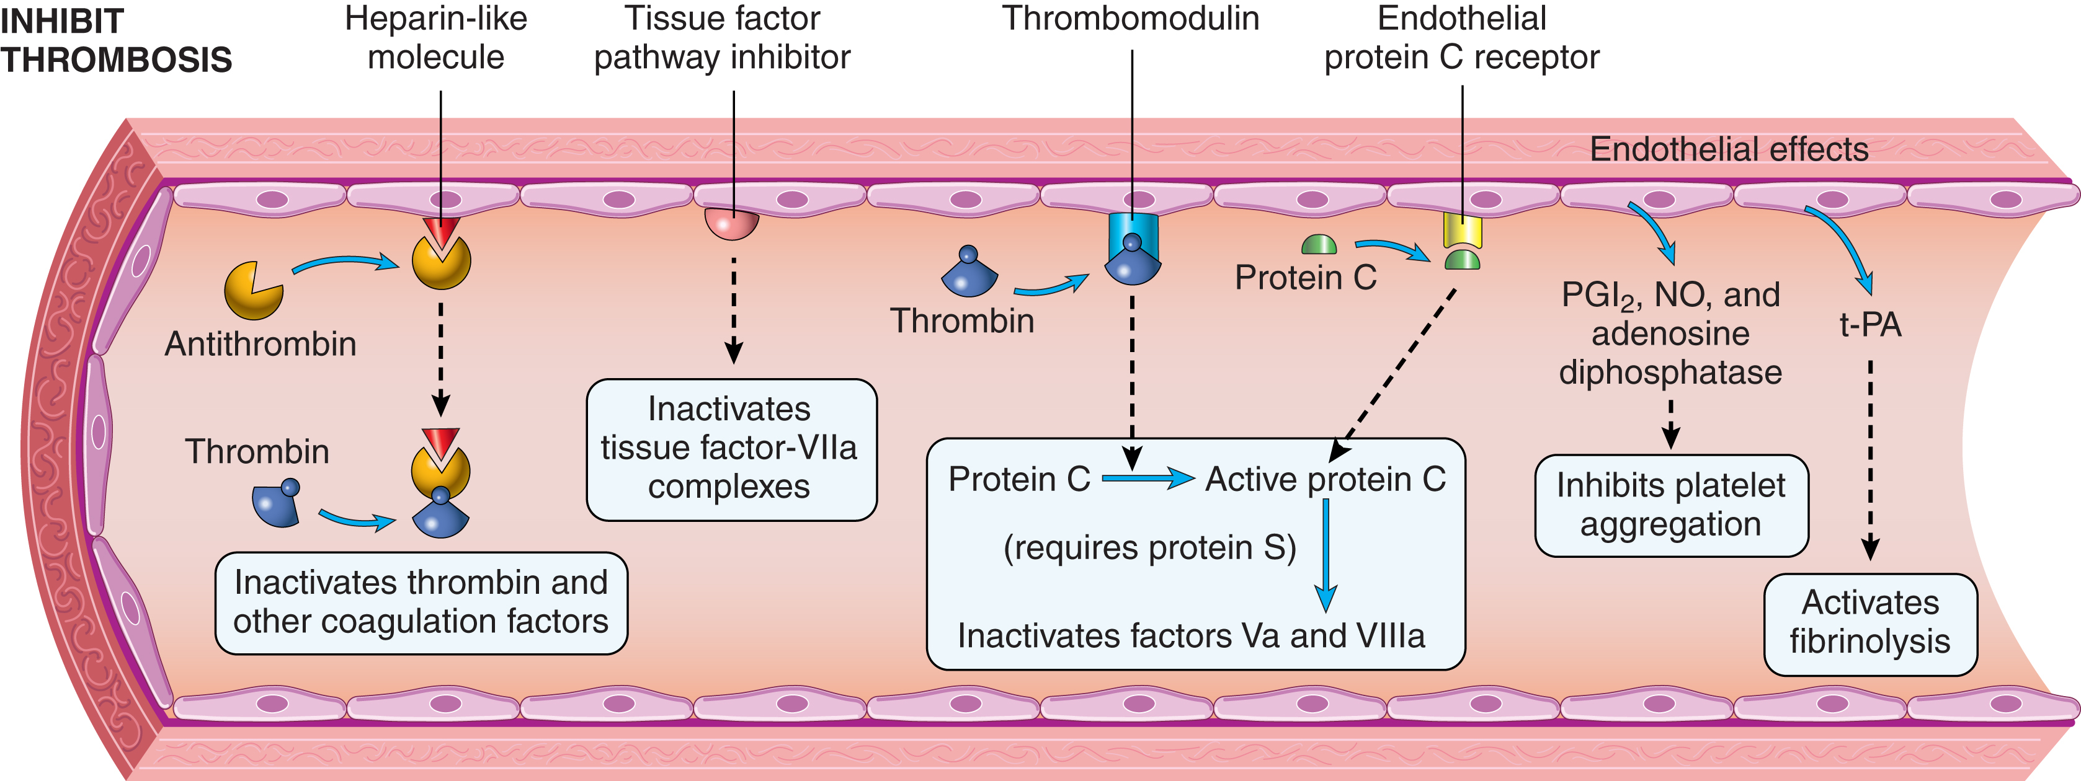
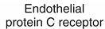
Normal EC Cells Express Molecules that Inhibit Coagulation and Promote Fibrinolysis
Xa (IXa, XIa)
Adapted from Robbins Basic Pathology (2013), Chapter 3, Figure 3.11
Notes:
The illustration is a considerable, although understandable, oversimplification. Many events such as antithrombin inactivation of thrombin and the generation active protein C occur at endothelial surfaces.

Slide 39
Endogenous (In Vivo) Anticoagulants
Tissue Factor + VII
Tissue Factor Pathway Inhibitor (TFPI)*
IX
Antithrombin III (AT III)**
+ EC heparin-like molecules
TF-VIIa
XIa
X
IXa
Prothrombin
VIIIa
Xa
Va
Active Protein C (APC)
Thrombin binds to thrombomodulin on EC membranes and activates membrane bound Protein C.
APC then cleaves VIIIa and Va in the presence of Protein S.***
XIII
Thrombin
XIIIa
Fibrinogen
Fibrin
(weak)
Fibrin
(strong)
There is no need to memorize all the pathways, but appreciate the redundancy and know the major sites of Antithrombin III action
Plasmin-mediated
Fibrinolysis
Notes:
This complex slide has a build. The purpose is to emphasize the redundancy of endothelial cell dependent anticoagulant activities.
* Tissue factor pathway inhibitor (TFPI) has more than one isoform that are differentially expressed by platelets and endothelial cells. TFPI first inhibits free Xa and then the complex inhibits TF/VIIa.
** Therapeutic heparins bind also interact with ATIII.
*** Protein C and protein S are vitamin K-dependent proteins synthesized in the liver. This allows the proteins to attach to negatively charged platelet membranes in proximity to Va and VIIIa..

Slide 40
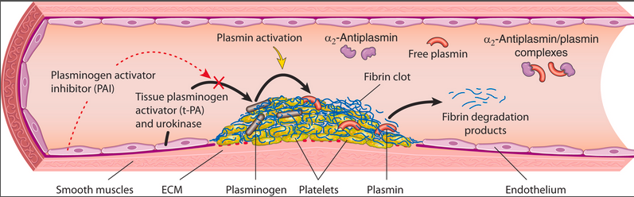
Fibrinolytic System*
Activation of Fibrinolysis:
Platelet-fibrin clots form at sites of EC injury and circulating plasminogen binds to the clots.
Activated ECs secrete tissue plasminogen activator (tPA).
tPA binds to clots, cleaves plasminogen to plasmin, which degrades fibrin and dissolves the clot.
Activation of the coagulation cascade increases fibrinolysis to limit the size of the clot and contribute to its later dissolution.
Inhibition of Fibrinolysis:
tPA is inhibited by activated plasminogen activator inhibitor (PAI), which is synthesized in increased amounts by activated ECs.
Free plasmin is also inhibited by circulating inhibitors
Robbins Basic Pathology, 2023 – Figure 3.10

Slide 41
Hemostatic Balance
Normal hemostasis requires a precise spatial and temporal balance between coagulation and fibrinolysis activators and inhibitors.
Coagulation
Fibrinolysis

Slide 42
Key Concepts Distilled Essence of Secondary Hemostasis and Fibrinolysis
EC injury leads to exposure of TF with the resulting activation of Factor VII. The TF/VIIa complex initiates a proteolytic cascade leading to factor Xa-catalyzed conversion of PT to T.
Reactions require membranes of activated platelets and calcium. Calcium binding to vitamin K-dependent factors plays critical roles.
After initiation, thrombin feedback amplifies the cascade at multiple points. Thrombin can play other roles via cleavage of protease-activated receptors.
Thrombin converts fibrinogen to fibrin and activates FXIII leading to fibrin crosslinking of the plug.
Coagulation is limited by circulating and locally generated endogenous anticoagulants, including Antithrombin III, Active Protein C, and Protein S
Tissue plasminogen activator (tPA) is released by activated ECs and binds to the fibrin clot, leading to plasmin-dependent fibrinolysis.
Fibrinolysis is regulated by locally generated and circulating inhibitors.
A precise balancing of coagulation and fibrinolytic events is essential
Notes:
Although not emphasized here, coagulation mechanisms play important roles in inflammation, In regulating the response to inflammatory mediators, and in innate host defense.

Slide 44
Hemorrhage
Hemorrhage is defined as the rupture of a vessel or capillary with the release of blood into surrounding tissues or body spaces.

Slide 45
Etiologies of Hemorrhage
Most common cause is trauma but can be associated with many acquired and inherited disorders.
Marked reduction in platelets (thrombocytopenia) is one of the most common predisposing factors.
Notes:
The biggest concern is hypovolemic shock

Slide 46
Thrombocytopenia < approx. 150,000 platelets per μl
General mechanisms*
Decreased platelet production
Decreased platelet survival
Sequestration in the spleen
Dilution
Notes:
* No need to know the more specific mechanisms for Module 2. However, additional information is provided below.
Decreased Platelet Production
Drugs, e.g., alcohol, cytotoxic drugs
Nutritional deficiencies (B12, folate)
Liver disease (thrombopoietin deficiency)
Marrow replacement, e.g., cancer, granulomatous disease
Certain infections
Aplastic anemias
Decreased Platelet Survival
Immunologic destruction
Non-immunologic destruction, e.g. DIC, sepsis thrombotic microangiopathies
Sequestration in spleen (splenomegaly of various causes, sickle cell)
Dilution with massive transfusions

Slide 47
Abnormal Bleeding and Consequences General Principles & Terminology per Robbins
Defects of Primary Hemostasis
vWF deficiency and platelet deficiencies or defective function
Most characteristic are small or punctate bleeds into skin, mucosal tissues, and serosal surfaces referred to as petechiae
Sometimes larger hemorrhagic lesions referred to as purpura
Intracerebral hemorrhage with very low platelets
Defects of Secondary Hemostasis
Acquired or inherited deficiencies of coagulation factors
Bleeding into soft tissues and skeletal muscle
Bleeding into joints, particularly with hemophilia (hemarthrosis)
May cause even larger ecchymoses or bruises
Bleeding is often more generalized or involves multiple sites
Notes:
All the disorders can have a range of presentations from mild to severe. The clinical significance depends on the location and amount of blood loss. Any significant bleed into soft tissue can result in an extravascular accumulation of blood or hematoma.

Slide 48
Bleeding into Tissue Spaces Terminology
Hemopericardium: pericardial space
Hemoperitoneum: peritoneum
Hemothorax: pleural space
Hemarthrosis: joint space
Notes:
All the disorders can have a range of presentations from mild to severe. The clinical significance depends on the location and amount of blood loss. Any significant bleed into soft tissue can result in an extravascular accumulation of blood or hematoma.

Slide 49
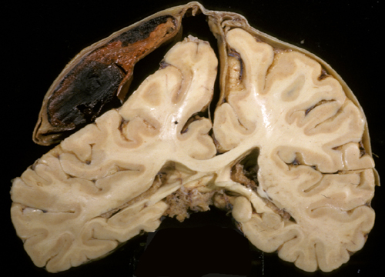
Hematoma Collection of Extravascular Blood*
Dura
Blood
Herniated brain
Gross of organizing subdural hematoma after fixation
Notes:
* Bleeding into tissue or a potential space
As you will learn from Gross Anatomy, blood and blood rich tissues have a brown color after fixation. Over time extravascular blood becomes organized. Blood cells break down and are internalized by macrophages. The extravasated blood or defect is gradually replaced by fibrous connective tissue, usually containing hemosiderin. Organized thrombi will usually appear tan.

Slide 50
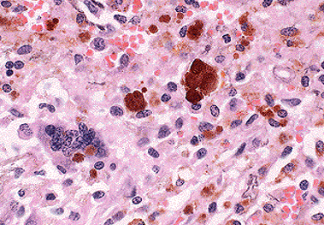
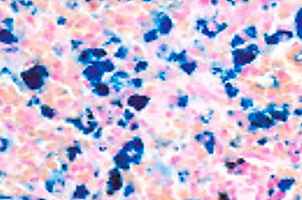
Hemosiderin
Hemosiderin in a hematoma
Macrophages internalize and degrade heme derived from extravasated erythrocytes.
Iron-ferritin complexes accumulate in phagolysosomes and appear as brown pigment
H&E
Iron Stain
Notes:
Hemosiderin is usually a “honey brown.” pigment. Because other materials can resemble hemosiderin, an iron stain in conjunction with other stains can be used to further confirm derivation from heme.

Slide 51
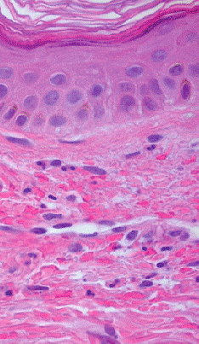
“Non-blanching” Hemorrhagic Lesions Understanding the Colors
Factors that determine color
Epidermal pigmentation
Depth of injury from body surface
Proximity to site of bleeding
Time interval since injury and the extent of hemoglobin conversion to biliverdin and bilirubin
Hb
Biliverdin
Bilirubin
Dermal RBC Extravasation
Recent Injury
Old
Notes:
Because red cells are released into the tissue in association with hemorrhage, the color does not change (blanch) with pressure. An erythematous lesion that loses its redness when pressed is referred to as blanchable or a blanching lesion. The indicates the presence of flowing blood; areas of hyperemia or vascular proliferation will usually blanch. Non-blanching lesions are indicative of red cell extravasation into the tissue.
Hemoglobin derived from red cells is sequentially converted to biliverdin and bilirubin, contributing to time dependent changes in the color of hemorrhagic lesions. However, there are other factors as listed above.
Lesions are less visible on dark skin.

Slide 52
Terminology for “Non-blanching” Hemorrhagic Lesions of Skin
SMALL Pinhead to few mm | MEDIUM Few to several mm | LARGE > about 1 cm
Petechiae | Purpura | Ecchymosis
No widely accepted or sharp size cut-offs
Notes:
The terminology is commonly used to describe hemorrhagic skin lesions. Size cut-offs vary widely in the literature. As a practical matter, no one measures the lesions to figure out what to call them. A given patient can have lesions of varying size.
As indicated previously, petechiae and purpura usually result from defects in primary hemostasis (e.g., deficiencies of platelets or vWF). Defects in secondary hemostasis (e.g., clotting factor deficiencies) more often result in more extensive soft tissue hemorrhages or hemorrhages into joints.

Slide 53
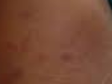
Impact of Skin Pigmentation
SMALL Pinhead to few mm | MEDIUM Few to several mm | LARGE > about 1 cm
Petechiae | Purpura | Ecchymosis
More difficult to see lesions on dark skin, they can appear brown to black
Clinical photo showing purpuric lesions with N. meningitidis sepsis!

Slide 54
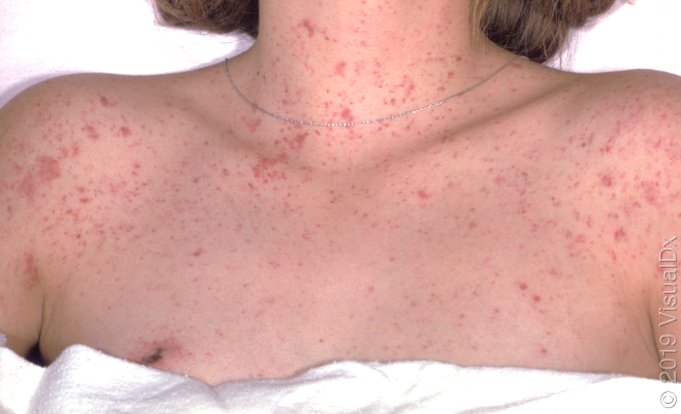
Purpura and Numerous Petechiae
Clinical Photo
Notes:
Yes, there are a few larger lesions that could be categorized as purpuric (circled), but this is a nice example of a petechial rash. I am uncertain of the etiology.

Slide 55
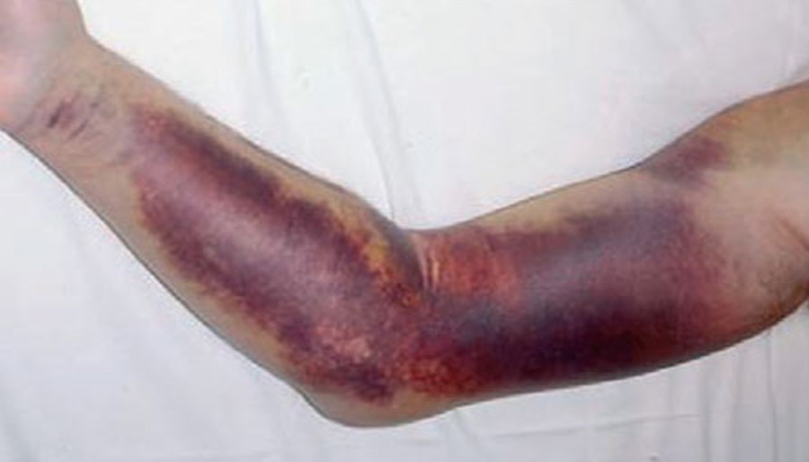
Ecchymosis with Hemophilia
Ecchymosis
Clinical Photo

Slide 56
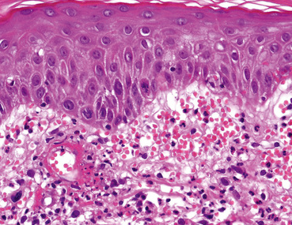
Generalized Defects of Small Vessels Scurvy, Amyloidosis, Vasculitis
Varied presentations from petechiae to ecchymoses
Epidermis
Vasculitis is often associated with “palpable purpura” which presents as elevated, firm, hemorrhagic papules or plaques up to several centimeters in diameter
Blood
H&E – dermal vessel with fibrinoid necrosis (circled) and extravasated RBCs
Notes:
Vasculitis refers to inflammatory/immune or pathogen-mediated damage to blood vessels.
Palpable purpura and ecchymosis are more characteristic of systemic disorders associated with extensive damage to small blood vessels (e.g., with systemic vascular inflammation or vascular fragility) and extensive red cell extravasation.

Slide 58
Introduction to Clinical Testing
As indicated in the roadmap, you need to become very familiar with the laboratory coagulation cascade, including the extrinsic, intrinsic, and common pathways as discussed in the reading.
You should be able to apply your knowledge of the laboratory and extrinsic pathways of coagulation to interpret simple clinical scenarios and lab tests reporting PT and PTT. Reference ranges are always provided.

Slide 59
Potential Clinical Presentations of Mild Bleeding Disorders Selected Examples
Easy “bruising”
Bleeding gums or unexplained nosebleeds
Excessive bleeding from small cuts or dental work
Heavy menstrual bleeding
Excessive bleeding following surgery
Symptoms and signs of anemia
Abnormal screening test results
Other . . .

Slide 60
Clotting Cascade in the Lab Routine Coagulation Testing (PT)
Prothrombin time (PT)
Extrinsic (and Common) Pathways
Citrated plasma + recombinant tissue factor (TF) + phospholipids + calcium (and heparin inhibitor)*
Record time to form fibrin clot
For patients on warfarin, normalize to standard control plasma for international normalized ratio (INR). Routinely used to monitor warfarin therapy as subsequently discussed by Dr. Pennington.
Notes:
* Historically the test included a brain extract (thromboplastin) that contains both tissue factor and lots of phospholipids. In most labs this has been replaced by recombinant TF and defined phospholipids.
Although TF/VIIa can directly initiate the common pathway, IXa enhances activation of X the and leads to more robust clot formation.

Slide 61
Clotting Cascade in the Lab Routine Coagulation Testing (aPTT)
Activated Partial Thromboplastin Time (aPTT)*
Intrinsic (and Common) Pathways
Citrated plasma + negatively charged particles + phospholipids + calcium – No TF
Record time to form fibrin clot
Notes:
* Thromboplastin is no longer used for testing. It consisted of a mixture of phospholipids and TF isolated from tissue. Partial thromboplastin indicates that the test includes phospholipids but no TF.
The PTT is usually performed as an activated PTT (aPTT) that results in more rapid clotting. There are various activators, e.g., kaolin, silica, ellagic acid, and phospholipids.

Slide 62
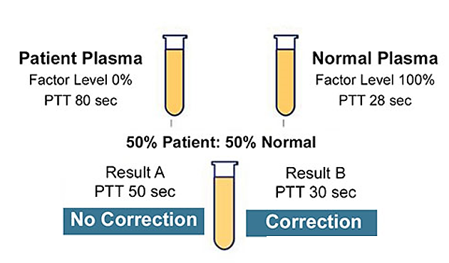
Mixing Tests and Coagulation Testing* Not in Reading - For Future Information
Mixing of patient and normal plasma can be used to help distinguish:
Deficiencies of clotting factors
Presence of coagulation inhibitors
Mixing corrects factor deficiency but not normalized with an inhibitor
Example
Inhibitor
Factor Deficiency
Notes:
* Normal plasma has sufficient excess of factors to allow considerable dilution without significantly affecting the clotting time. Similar strategies can be used to look for correction with purified coagulation factors.

Slide 63
Test Interpretation For Future Information
Complexities to keep in mind:
FVIII is bound to vWF, so vWF deficiency can prolong the aPTT
The PT test has more phospholipid, so it is less effected in “antiphospholipid” disorders than aPTT
The PT test has more added heparin-binding components, so it is less sensitive to unfractionated heparin than aPTT
Common pathway activation and function requires vitamin K-dependent factors (II, VII, IX, X) but FVII has a short half-life, so PT/INR is preferentially affected by vitamin K deficiency (VKD)

Slide 64
Abnormal Routine Coagulation Tests in Otherwise “Healthy” Patients Selected Potential Causes for Future Information
Medications, Medications, Medications
Vitamin K deficiency (VKD), e.g., hepatobiliary disease, intestinal malabsorption, antibiotics and other drugs, alcohol toxicity other . . .
Specimen collection or transport issues
Notes:
Vitamin K deficiency is a relatively common cause in infants because only small amount of vitamin K pass through the placenta and the microbiome is not yet fully developed. Primary vitamin K deficiency (VKD) is rare in adults except with severe malnutrition.

Slide 65
Medications and Supplements Associated with Abnormal Bleeding
Drug or Class of Substance | Mechanism(s)
Anticoagulants | Interfere with clot formation
Antiplatelet agents, e.g., NSAIDS | Interfere with platelet function
Glucocorticoids | Can compromise vascular integrity
Antibiotics | Can cause vitamin K deficiency, esp. with longer use, and some interfere with platelet function
Alcohol | Liver disease can lead to vitamin K deficiency and thrombocytopenia
Vitamin E as example of a supplement | Large amounts can potentially interfere with vitamin K metabolism and may inhibit platelet aggregation
Adapted from more complete list in UpToDate: Approach to Adult with Suspected Bleeding Disorders, 2021
For Future Information
Notes:
Selective serotonin release inhibitors (SSRIs), which are often used to treat depression, can be associated with bleeding secondary to depletion of platelet serotonin and inhibition of platelet activation (Module 7)

Slide 66
Clotting Cascade in the Lab Examples of test Interpretation – Patients with Abnormal Bleeding*
PT - Extrinsic
Normal PT and aPTT
Most often a vWF or platelet disorder
Isolated Prolonged PT/INR
Warfarin or vitamin K deficiency
Early liver failure
Factor VII deficiency (rare)
Isolated Prolonged aPTT
Unfractionated heparin
von Willebrand Disease (Factor VIII)
Deficiency of an intrinsic pathway factor
“Lupus anticoagulant”
Prolonged PT/INR and aPTT
Warfarin or severe vitamin K deficiency
Severe liver disease
Common pathway deficiency
aPTT - Intrinsic
Selected examples for future information.
Notes:
* Findings are influenced by the design of the assays and specific components in each assay. For example, the phospholipid concentration and heparin binding components are higher in the PT assay.

Slide 67
Preanalytical Variables* For Future Information
Traumatic blood collection or prolonged application of tourniquet
Collection in non-inert tubes
Inadequate filling of tube
Heparin contamination when drawing from heparinized lines
Inadequate mixing of blood after collection
Improper order when collecting multiple tubes
Not noticing that the hematocrit is too high (>55%)
If something doesn’t make sense, repeat the test.
Notes:
* Traumatic Collection. Needles >23 gauge to avoid mechanical damage to platelets and RBCs. Trauma must be minimized during venipuncture to avoid hemolysis and contamination with procoagulants. Prolonged application of the tourniquet (>1 min) can reduce venous circulation and increase procoagulants.
Collection in Non-inert Tubes. Collection containers must be composed of nonreactive or nonwettable materials such as siliconized glass or plastic to avoid activating the contact (intrinsic) pathway.
Inadequate Tube Filling. Evacuated collection tubes must be filled to completion to ensure the proper blood to anticoagulant ratio is achieved. To much anticoagulant and clotting will be delayed.
Heparin Contamination. Heparin contamination can occur when the sample is drawn inappropriately from arterial or central venous line. Blood for coagulation testing should never be collected from heparinized lines. When blood is drawn through an indwelling catheter, the line should be thoroughly flushed and the first 5 mL of blood discarded. Despite efforts to flush heparin from the lines, heparin contamination can still occur.
Inadequate Mixing. It is critical that the collected sample be mixed immediately by gentle inversion at least six times to ensure adequate mixing of the anticoagulant with the sample. Inadequate mixing can lead to clot formation, depleting coagulation factors and resulting in erroneous results.
Other Contamination. When multiple tubes are collected, collect sterile and non-additive red-top tubes prior to citrate [blue-top] or other anticoagulant containing tubes.
High hematocrit can lead to a falsely prolonged coagulation time because it decreases the plasma volume and increases the effective concentration of the anticoagulant. You may want to contact the lab if there is no reflex procedure to add more anticoagulant.

Slide 69
Optional Information Regarding Hemostasis
Review of the following tables may be helpful, now or for future reference.
Information not addressed in the required reading is not testable content for Module 2.

Slide 70
 | Name(s) | Type | Site of synthesis | Roles
I | Fibrinogen | Glycoprotein (dimer of trimers) | Liver, some internalized and stored in platelets | Cleaved by thrombin to generate fibrin
II | Prothrombin | Serine protease | Liver* | Precursor of thrombin, and the central player in normal and pathologic clotting
III | Tissue Factor, tissue thromboplastin | Membrane glycoprotein | Many cells including activated endothelial cells | Initiator of clotting in vivo and of the extrinsic lab pathway
V | Factor V | Glycoprotein cofactor | Liver, stored and activated in platelets | Cofactor in prothrombinase complex for conversion of II to thrombin. Va amplifies coagulation on platelet membranes
VII | Proconvertin | Serine protease | Liver* | TF/VIIa initiates clotting in vivo and extrinsic lab pathway
VIII | Antihemophilic factor A | Glycoprotein cofactor | Endothelial cells, particularly liver ECs | Cofactor in ten-ase complex for activation of Factor X on platelet membranes. Carried in blood by vWF.
IX | Antihemophilic factor B, Christmas factor | Serine protease | Liver* | Protease in ten-ase complex. IXa/VIIIa activates X for clotting in vivo.
X | Stuart Factor | Serine protease | Liver* | Enzymatic component of prothrombinase complex. Tissue Factor Pathway Inhibitor (TFPI)/Xa complex inhibits TF/VIIa
XI | Antihemophiliac factor C | Serine protease | Liver | Key role for clotting in vivo through activation of Factor IX after its activation by thrombin
XII | Hageman factor | Serine protease | Liver | Deficiency can be associated with thrombosis. Links coagulation to inflammation and innate immunity
XIII | Fibrin stabilizing factor | Enzyme | Active subunit by megakaryocytes | Tranglutaminase that crosslinks and stabilizes the fibrin clot
vWF | von Willebrand factor | Multimeric glycoprotein | Endothelial cells, megakaryocytes, stored in platelets | Platelet binding, aggregation, activation
* Vitamin K dependent
Notes:
Note that there is considerable controversy in relation to the factors that can be synthesized in human platelets vs those that can be internalized and stored in granules. I left it purposefully ambiguous.

Slide 71
 | Name(s) | Vitamin K | Classic Lab Pathway | Abnormal Tests | Bleeding diathesis with deficiency
I | Fibrinogen |  | Common | PT, aPTT | Mild to severe depending on deficiency but very rare (1-2 per million). Dysfunctional forms can predispose to thrombosis.
II | Prothrombin | Required | Common | PT, aPTT | Mild to severe depending on deficiency but very rare (1 per 2 million)
III | Tissue Factor, tissue thromboplastin |  | Extrinsic | Would require specific tests | Embryonic lethal in null mice, deficiencies not well described in humans
V | Factor V |  | Common | PT, aPTT | Moderate to severe, but very rare (1 per million)
VII | Proconvertin | Required | Extrinsic | PT | Moderate to severe. Rare (1 in 300-500,000) but most common cause with AR inheritance.
VIII | Antihemophilic factor A |  | Intrinsic | aPTT | Moderate to severe. Hemophilia A is the most common hereditary factor deficiency (1 in 5000 males). X-linked but can sometimes occur in females. Considerable clinical and genetic heterogeneity.
IX | Antihemophilic factor B, Christmas factor | Required | Intrinsic | aPTT | Moderate to severe. Hemophilia B is the second most common hereditary deficiency associated with moderate to severe bleeding (1 in 25,000 males). X-linked with considerable clinical and genetic heterogeneity.
X | Stuart Factor | Required | Common | PT, aPTT | Moderate to severe but very rare
XI | Antihemophilic factor C |  | Intrinsic | aPTT | Mild. Deficient in Hemophilia C. 1 in 100,000. Autosomal recessive; most common non-X-linked hemophilia.
XII | Hageman factor |  | Intrinsic | aPTT | Deficiency is rare (1 per million) No bleeding, but does other interesting things
XIII | Fibrin stabilizing factor |  | N/A | Requires specific tests | Mild to severe bleeding but extremely rare (1 per 5 million). Clots form but break down. Difficult to recognize with routine tests.
vWF | von Willebrand factor |  | N/A | Platelet aggregation assays; sometimes aPTT | Deficiency of vWF is the most common inherited bleeding disorder (1% of US). Usually mild but clinically and genetically heterogeneous. Can result in deficiency of FVIII which can result in prolonged aPTT
Notes:
Factor IV = calcium ions
Factor VI proved to be Va, no longer assigned
Moderate to severe bleeding: 5,6,7,8,9,10 but there is no 6

Slide 72
Endogenous Anticoagulants
Endogenous Anticoagulant | Other Names | Type | Synthesis | Comments
Antithrombin (AT) | Antithrombin III | Circulating and EC bound serine protease inhibitor (SERPIN) | Liver | Activated by heparan sulfate domains of HSPGs on ECs. Deficiency can lead to thrombosis. Activated by heparin and is the primary inhibitor of thrombin and factors IXa and Xa, but can bind to other serine proteases. Deficiency can lead to thrombosis.
Tissue Factor Pathway Inhibitor (TFPI) |  | Circulating and EC bound SERPIN | Liver, endothelial cells and other | TFPI/Xa complex inactivates Tissue Factor/VIIa complexes. Activation of platelets by thrombin and collagen causes the release of TFPI.
Protein C | XIV | Circulating protease | Liver, vitamin K dependent | Activated by Thrombin/Thrombomodulin complex when protein C is bound to endothelial protein C receptor. Active Protein C/Protein S complex binds to activated platelet membranes and inhibits coagulation by cleaving Va and VIIIa. Deficiency can lead to thrombosis.
Protein S | PROS, Protein S antigen | Circulating plasma glycoprotein | Liver, vitamin K dependent | Cofactor for activated protein C and TFPI but plays other biological roles. Circulates free and bound to C4b binding protein. Deficiency can lead to thrombosis.
Thrombomodulin | TM, CD141 | Membrane receptor | Endothelial cells and other cells | High affinity thrombin receptor on endothelial cells. Thrombin/TM activates Protein C as above and inactivates Factors Va and VIIIa.
Heparin-like molecules |  | Heterogeneous sulfated and non-sulfated HSPGs | Endothelial cells | Expressed in association with glycocalyx on luminal surface of EC cells. Activates Antithrombin III

Slide 73
Fibrinolytic System
Molecule | Other Names | Type | Synthesis | Roles
Plasmin |  | Serine protease | Liver as plasminogen | Promotes fibrinolysis but plays many biological roles. Plasmin is inactivated by a2 macroglobulin and α2-antiplasmin.
Tissue plasminogen activator | tPA or TPA | Serine protease | Endothelial cells | Promotes fibrinolysis by converting fibrin bound plasminogen to plasmin. Recombinant forms are used clinically to disrupt clots. Inhibited by PAIs. There are other plasminogen activators, e.g., urokinase (uPA).
Plasminogen activator inhibitors | PAI | SERPIN – protease inhibitor | Activated endothelial cells | Inhibits fibrinolysis by inhibiting plasminogen activator, i.e., a procoagulant effect
Factor XII | Hageman factor | Serine protease | Liver | Can generate plasmin from plasminogen
Thrombin Activatable Fibrinolysis Inhibitor | TAFI, Carboxypeptidase B2 | Carboxy-peptidase | Liver | Inhibits fibrinolysis. TAFI removes C-terminal binding sites on fibrin for tPA and plasminogen, decreasing the ability of fibrin to stimulate fibrinolysis. Elevated levels of TAFI have been associated with an increased risk of venous thrombosis. Thrombin activation is mediated by TM/thrombin complex

Slide 74
Optional Supplementary Slides Hemostasis

Slide 75
Vascular Injury
Exposure of Subendothelial Matrix
Vasoconstriction
(transient, neuro-hormonal or neural)
Exposure of Tissue Factor
Platelet Plug
Primary Hemostasis
Coagulation Cascade
Secondary Hemostasis
Fibrin/Platelet Blood Clot
Fibrinolysis (as needed)
Notes:
This complex slide has a build.
“Primary” and “secondary” and the sequential display of primary and secondary hemostasis in the animation should not be interpreted as meaning the processes are sequential. They are parallel and interdependent. Both are almost instantaneously initiated following vascular injury

Slide 76
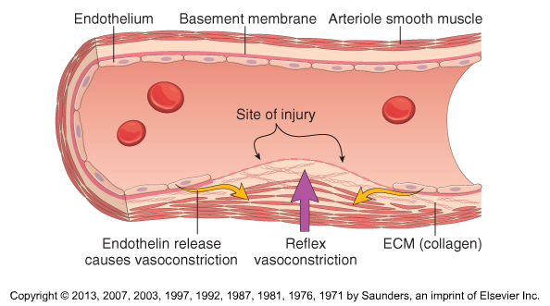
Arteriolar Vasoconstriction Neural reflexes and local release of vasoconstrictors

Slide 77
Optional Supplementary Slides Platelets

Slide 78
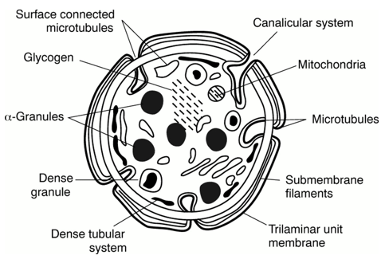
Review of Platelet Structure
Open canalicular system*
Dense tubular system*
Notes:
The open canalicular system (OCS) serves as a pathway for transport of substances into the cells and as conduits for the discharge of alpha granule products secreted during the platelet release reaction.
The dense tubular system (DTS) functions to regulate platelet activation by sequestering or releasing calcium

Slide 79
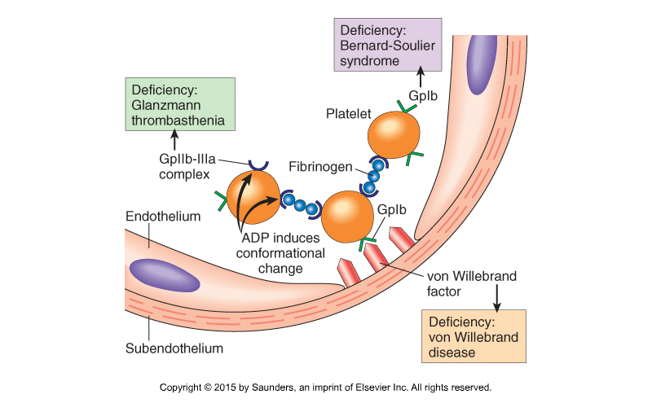
Platelet Aggregation and Activation Contributions of vWF and Platelet Receptors

Slide 80
Platelet Aggregation Contributing Mechanisms
Vascular Injury with Exposure of Subendothelial Collagen and vWF
Recruit more platelets
Recruit more platelets
Platelet Adhesion
Activation
Granule Release
ADP
Thromboxane A₂
ADP
Calcium
Other
Activation of Platelet
Integrin GPIIb/IIIa
The bottom line is that a variety of platelet-derived mediators can contribute to aggregation and creation of the platelet plug.
Crosslinking with Fibrinogen (and vWF)
Platelet Aggregation
Notes:
This complex slide has a build.
The interactions between platelets and exposed matrix is considerably simplified and involves a cascading series of progressively stronger receptor mediated interactions.
Glycoprotein IIb/IIIa is an integrin complex required for platelet aggregation and tight endothelial adherence. However, the active integrin receptor also binds to fibrinogen contributing to crosslinking of platelets and formation of the initial platelet plug.
ADP plays important roles in platelet activation, recruitment, and adherence. Effects are mediated by specific platelet receptors. As optional information for this event, human platelets possess 2 major purinergic ADP receptors: (1) the purinergic P2Y₁ receptor, which initiates platelet shape change and ADP-induced aggregation through the mobilization of internal calcium stores, and (2) the P2Y₁₂ receptor, which is coupled to adenylyl cyclase inhibition and is essential for a full aggregation response to ADP and the stabilization of aggregates. These are discussed in the subsequent lecture on antithrombotic pharmacology.
Thromboxane A2, which is produced by activated platelets (not preformed), has diverse effects but stimulates vasoconstriction and augments the expression of the GPIIb/GPIIIa complex. Production of TXA2 is inhibited by aspirin. Phospholipase A2 hydrolyzes membrane phospholipids to arachidonic acid, the initial substrate for cyclooxygenase 1 (COX-1) allowing synthesis of thromboxane A2.

Slide 81
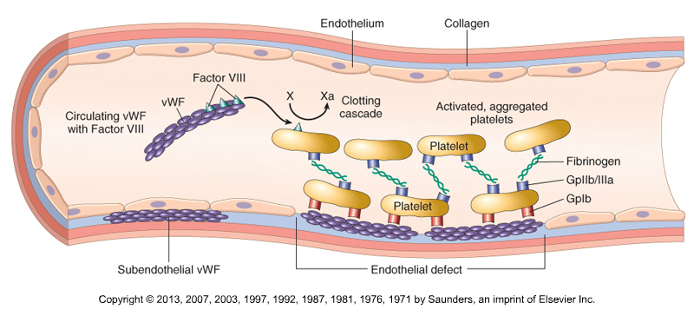
Platelet Aggregation and Activation Contributions of vWF
Robbins Basic Pathology, 2023 – Figure 10.31

Slide 82
Activities of Quiescent ECs that Inhibit Clotting Illustrated in Robbins Basic Pathology - Figure 3.11
Effects on Platelets
Limit access of platelets to subendothelial collagen and vWF
Synthesize and release inhibitors of platelet aggregation, e.g.,
PGI₂
Nitric Oxide (NO)
Effects on Coagulation
Express surface heparin-like molecules that bind to circulating AT III, predominantly contributing to the inactivation of thrombin, FXa, and FIXa
Secrete tissue factor pathway inhibitor
Express surface thrombomodulin, which binds thrombin, thereby activating Protein C and ultimately leading to inactivation of FVa and FVIIIa
Secrete tissue plasminogen activator (tPA), which promotes fibrinolysis

Slide 83
Functional Heterogeneity of Platelets Underappreciated Complexities and Controversy
Procoagulant population
Display surface phosphatidylserine
Assemble coagulation factor complexes with increased thrombin generation
Adhesive and contractile population
Bind to ECM proteins
Mediate clot retraction
Found closest to vessel wall
Subsets may be differentially engaged depending on the specific mechanism of activation, e.g., thrombin vs collagen vs dual modes etc.
Just remember that all platelets are not the same.

Slide 84
Optional Supplementary Slides Coagulation Factors

Slide 85
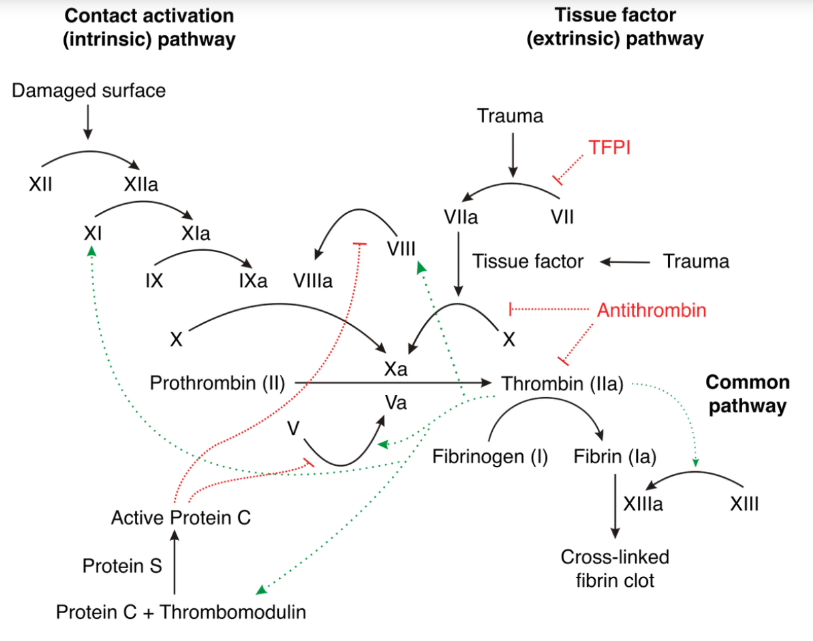
https://jonathanmclatchie.com/the-incredible-design-of-vertebrate-blood-clotting/

Slide 86
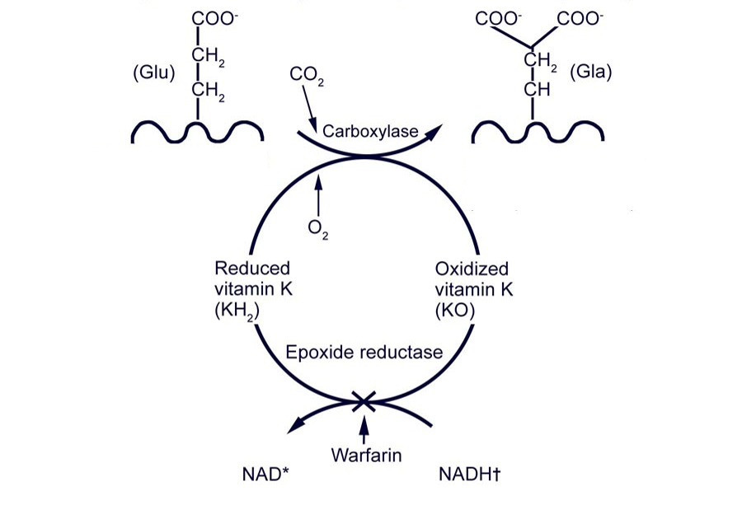
Carboxylation of Glutamic Acid Residues on Clotting Factors
Ca⁺⁺ binding
Glutamic
acid
γ-Carboxyglutamic acid
Clotting factor
Clotting factors II, VII, IX, X

Slide 87
Diverse Activities of Thrombin
Converts fibrinogen (I) into crosslinked fibrin, amplifies the coagulation cascade, and activates factor XIII
Inhibits fibrinolysis by activating the Thrombin Activatable Fibrinolysis Inhibitor (TAFI)
Enhances platelet activation and aggregation via protease activated receptors (PAR)
Activates ECs, inflammatory cells, and a variety of other cell types via PARs
Other . . .
Just remember that thrombin does much more than clot blood.

Slide 88
Thrombin and Host Defense
Mediates trapping of pathogens via fibrin clot
Activate various immune cells via PARs
Degradation of thrombin releases peptides with antimicrobial and anti-inflammatory activities
Other . . .

Slide 89
Normal EC Cells Express Molecules that Inhibit Coagulation and Promote Fibrinolysis
Xa (IXa, XIa)
Adapted from Robbins Basic Pathology (2013), Chapter 3, Figure 3.11
Notes:
The illustration is a considerable, although understandable, oversimplification. Many events such as antithrombin inactivation of thrombin and the generation active protein C occur at endothelial surfaces.

Slide 90
Optional Supplementary Slides Fibrinolysis

Slide 91
Control of Fibrinolysis & Generation of Fibrin Degradation Products
Thrombin
PAR
Endothelial Cells (ECs)
Tissue Plasminogen Activator (t-PA)
Serine protease most active on fibrin
EC-derived Plasminogen Activator Inhibitor (PAI)
Clot
X
Circulating
Plasminogen
Plasmin
α2-antiplasmin
Inactive Complexes
α2-macroglobulin
Soluble Fibrin
Degradation Products
As optional information, circulating Thrombin-Activatable Fibrinolysis Inhibitor (TAFI) cleaves fibrin and decreases ability of the clot to bind plasminogen and tPA
Fibrin Clot
Notes:
This complex slide has a build.
t-PA is a serine protease that is predominantly synthesized by ECs. It is most active when bound to fibrin, and as a result its activity localizes enzymatic activity of plasmin to fibrin clots. t-PA is the most important physiological activator and is also used clinically. Urokinase is another plasminogen activator. Plasminogen can also be converted to plasmin by Factor XIIa.
PAI (type 1) is synthesized by ECs. Its absence can be associated with bleeding and elevated levels can be associated with abnormal clotting.

Slide 92
Hemostatic Balance
Thrombin Generation
e.g., coagulation factors, platelets
Plasmin Generation
e.g., plasminogen activators, FXIIa
Coagulation
Fibrinolysis
Thrombin Regulation
e.g., thrombomodulin, antithrombin,
tissue factor pathway inhibitor
Plasmin Regulation
e.g., plasminogen activator inhibitors,
thrombin-activated fibrinolysis inhibitor
Simply remember that normal hemostasis requires a precise spatial and temporal balance between coagulation and fibrinolysis activators and inhibitors.
Notes:
As additional optional information: There are potential modulatory interactions between the thrombin and plasmin ends of the balance. For example, thrombin in the presence of thrombomodulin can activate thrombin activatable fibrinolysis inhibitor (TAFI), which interferes with plasminogen activation and slow fibrinolysis.
Gray – inhibition
Black – stimulation

Slide 93
Optional Supplementary Slides Bleeding

Slide 94
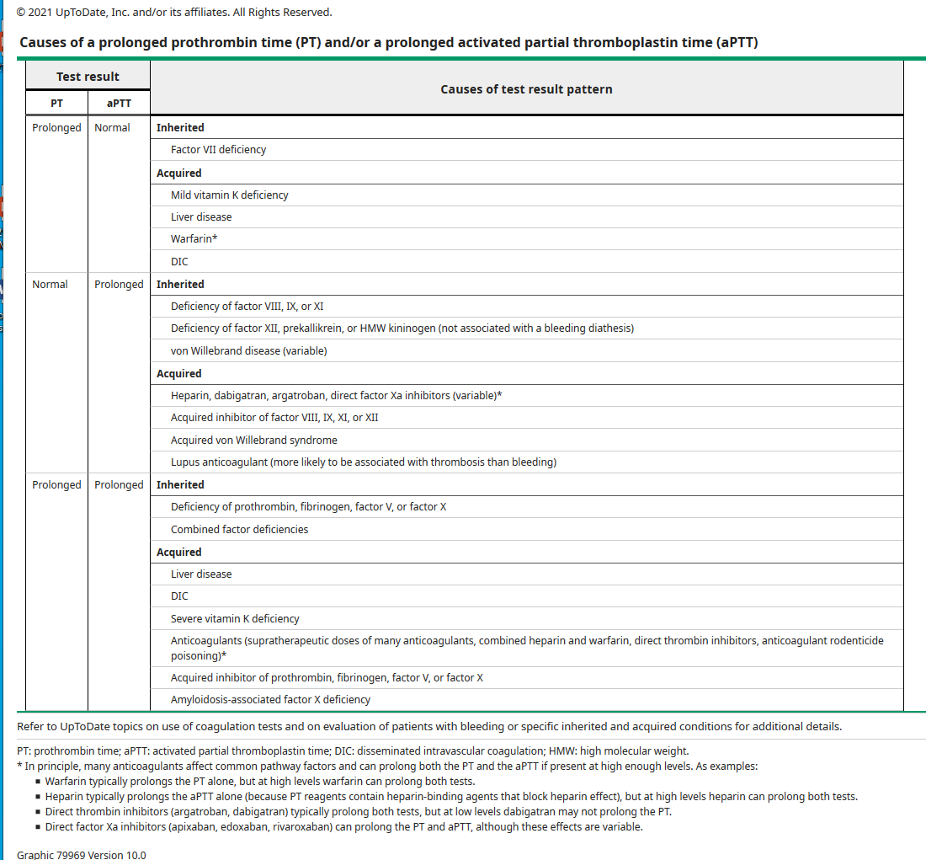
Rare
VII has shortest half-life of the vitamin K-dependent factors
PT may be preferentially affected early in course; both are usually prolonged.
Related to association of VIII with vWF
PT assay contains heparin binding components
Related to association of VIII with vWF
PT assay contains more PL and less affected
Common pathway
Decreased synthesis of coagulation factors
Particularly later in course. Consumption of coagulation factors
Decreased synthesis of active VK-dependent factors, affecting both pathways

